Slide 1
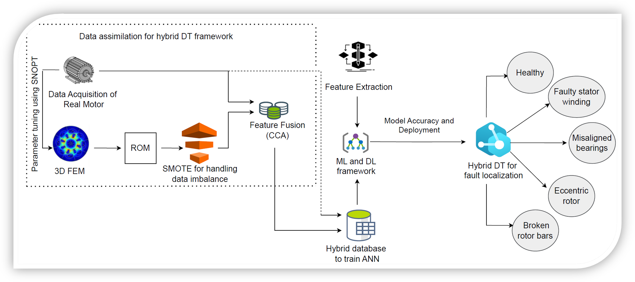
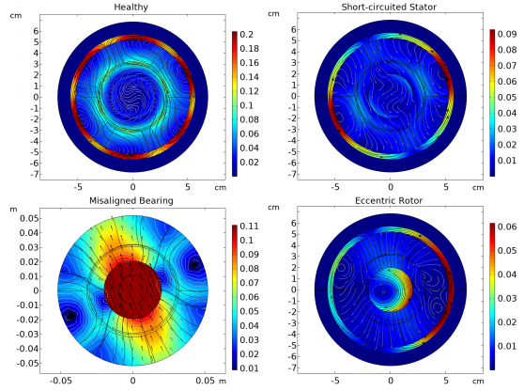
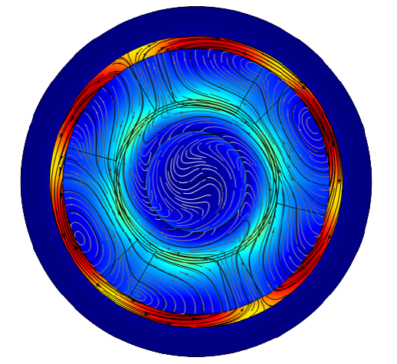
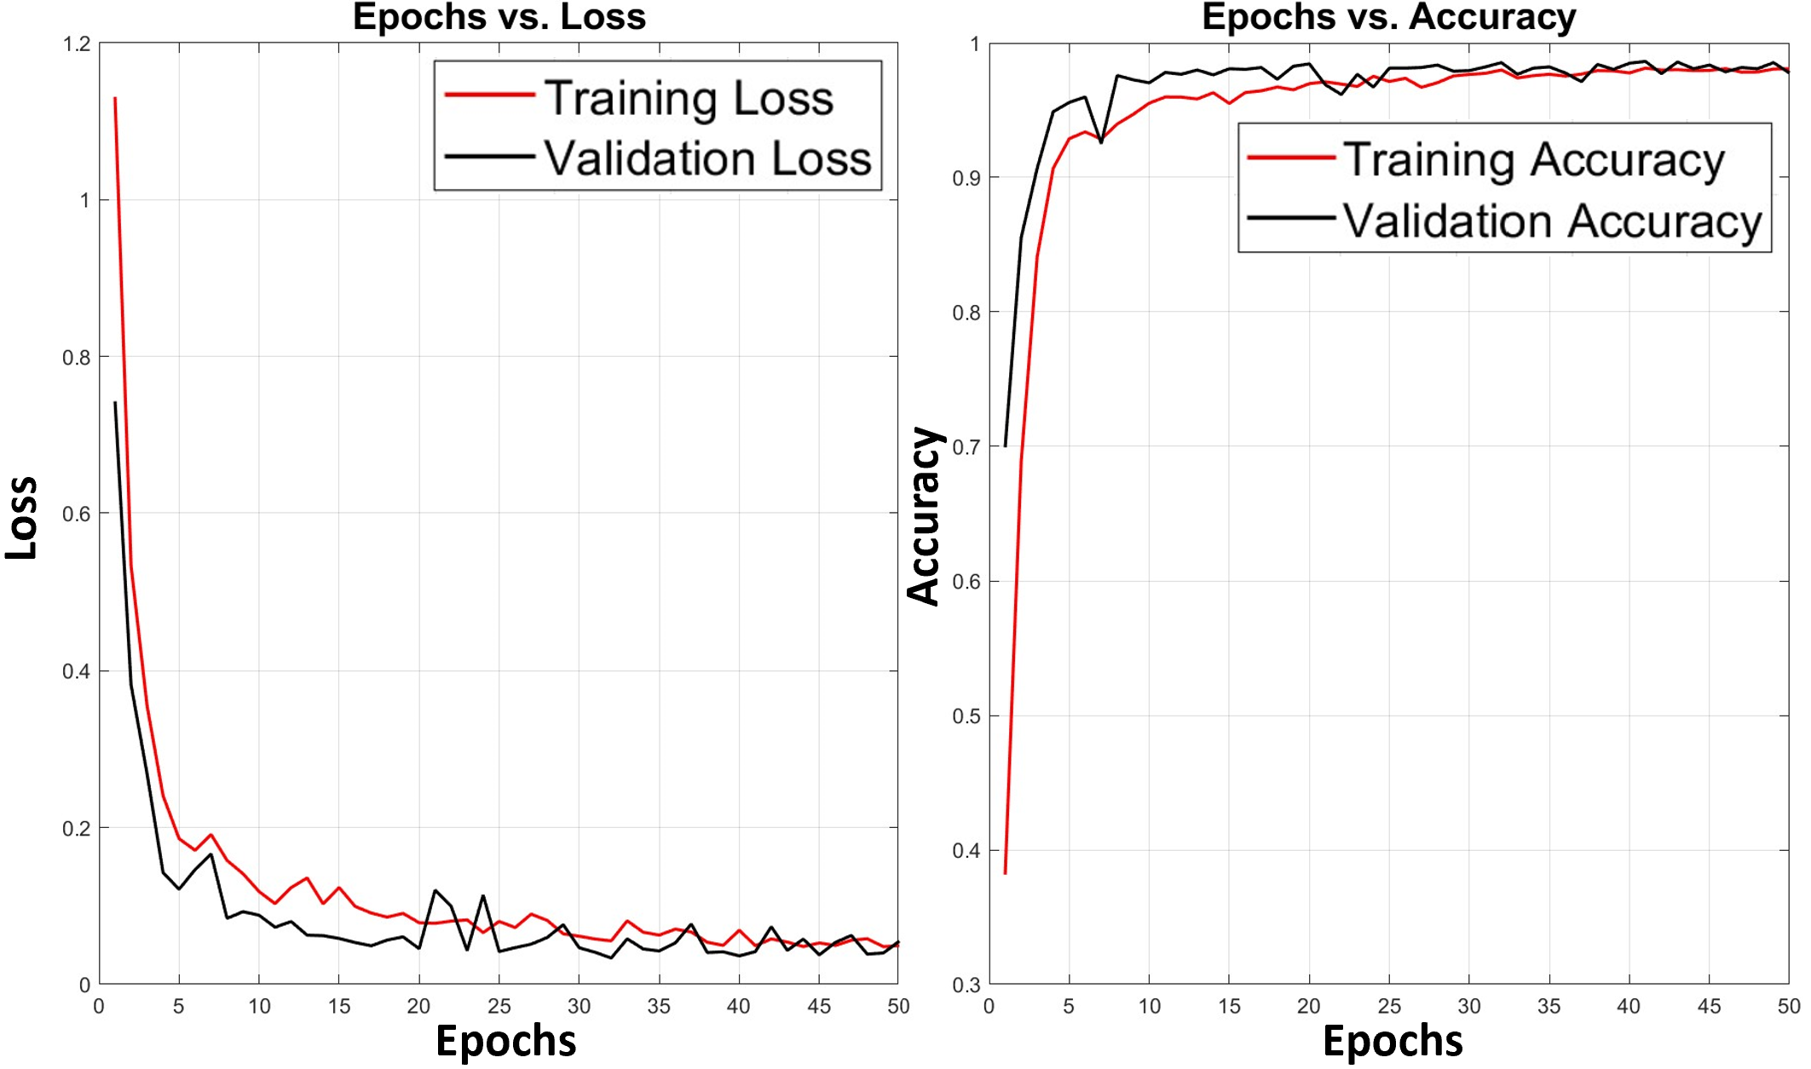
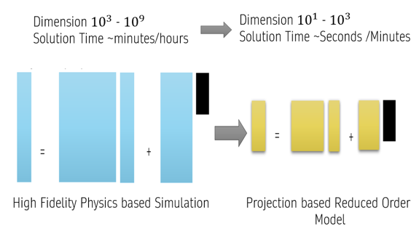
Multiphysics-Informed Digital Twin for Fault Localization in Induction Motor using AI
MIND TWIN AI
Amina Bashir¹, Muhammad Ahmed Mohsin¹, Muhammad Jazib¹, Dr Hafsa Iqbal
School of Electrical Engineering & Computer Science (SEECS), Islamabad, Pakistan
Department of Electrical Engineering DEE (PIEAS), Islamabad, Pakistan
Introduction Enabling the high-fidelity dynamic system to act as a virtual sensor exhibiting real-time capabilities. The aim is to design a Multiphysics-informed hybrid DT for fault detection and localization in TIM. Multiphysics-informed hybrid modeling approach enhances the interpretability of AI classifiers, improving real-time fault localization in TIM WHY Hybrid DIGITAL TWIN? Enhancing both Data and Physics Driven Modeling Provides Better Accuracy for Fault Localization in ML Classifiers Hybrid DT efficiently deals with the Data Sparsity and Data Mis-Interpretablility
Design Optimization Managing Data Sparsity Feature Fusion
Quantitative Results
The best model for hybrid DT was Subspace Discriminant, with an accuracy of 97.5%
CNN achieved the highest accuracy score of 98.87%
The data-driven model showed less accurate result, with the best model being Kernel Naive Bayes, showing an accuracy of 84.18%
K-Nearest Neighbors (Course) achieved the highest accuracy of 88.71% among the ML classifiers,
BIG DATA ALONE IS NOT ENOUGH
Digital Twins must incorporate the predictive power, interpretability, and domain knowledge of physics-based models
Figure 3. Working Methodology
Challenges for Predictive Digital TWIN
Predictive Modeling for Complex Systems at large scale
Verification, Validation and Uncertainty Quantification
Data, Models and decisions across multiple scales
Scalable Algorithms for updating ,prediction and Control
What is Physics Based Model
A representation of Governing Laws of Nature that innately embeds the concepts of time space and causality
Fig5 Comparison of magnetic flux density norm for healthy and faulty motors with short-circuited stator, misaligned bearing, and eccentric rotor
Loss and Accuracy Curves for Offset Prediction
Figure 1 .Presenting Magnetic Flux Density Norm for Healthy Motor
Mathematical and Computational Foundation
Physics Driven Modeling
Data Sparsity in Real Time Data
Data Driven Modeling
Data Acquisition of Healthy and Faulty Motor
Reduced Order Modeling
Design Optimization and Parameter Tuning
Future Work
Future works involve incremental ML and parallel computing approaches, enabling dynamic updates of DT as new data becomes available.
Further advancements can be made by exploring other methodologies to bridge the gap between physics-driven and data-driven modeling.
Data fusion techniques can also be used to model combinations of multiple faults within a particular TIM.
Figure 2. Reduced Order Models are Critical Enablers for Predictive Digital TWIN
Figure 4. Convergence of loss and accuracy curves for offset prediction using DL model over 50 training epochs.

